Slide 1
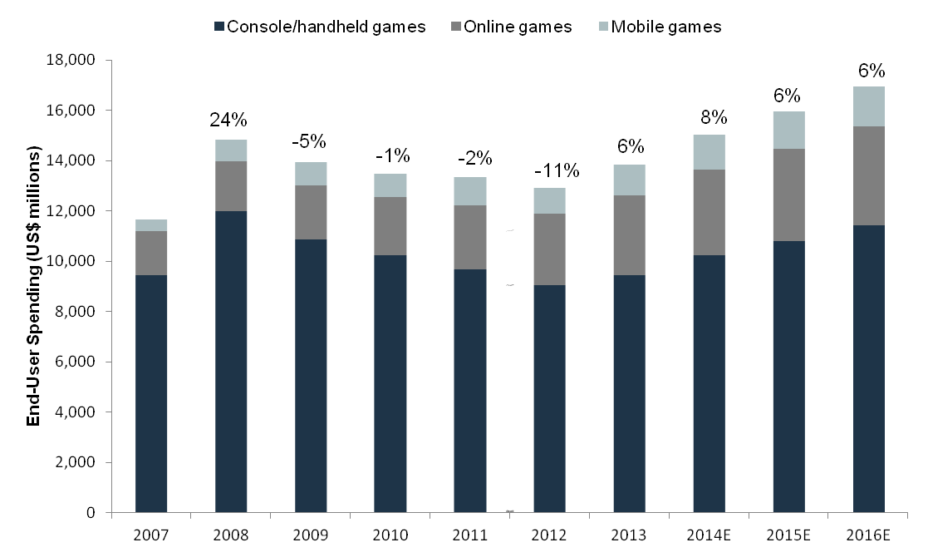
Industry – Statistics (Vide Games)
Industry Overview
North America Revenue by Major Segment (2014)
Physical games and software | $16.9bn
Consoles | $13.3bn
Online games and software | $7.0bn
Total revenue | $40.9bn
Forecasted 5-year revenue growth | 6.1%
EBITDA margins | 19.7% - 36.8%
North America Industry Characteristics
Total Debt/EBITDA | 3.5x
Total Debt/EV | 10%
EBITDA margin | 16.3%
EV/EBITDA | 8.0 – 10.4x
Cash Ratio | 1.1x
Market share held by 5 majors | 40.7%
Global Industry
Total revenues | $68bn
Forecasted 5-year revenue growth | 6.7%
Revenue Profile
Market declined in 2008 onwards due to dependency on discretionary spending but has been relatively resilient
Market has picked up in since 2012 due to improved confidence and growth in mobile/online segment
North America Video Game Industry by Segment ($bn)
Global industry sales by region (2012)
Average distribution of sales for video game publishers in 2014 (EA, ATVI, TTWO, UBI)

Slide 2
Industry – Overview (Video Games)
Video Games Industry Observations
Financial Aspects | Hit-driven profit: Profit is fairly volatile and margins are expected to grow based on lower cost of online distribution and increased sales due to intensive marketing for fewer Blockbuster releases Labor costs: Talented software developers are in high demand, resulting in high spending on labor costs reaching approximately $0.08 on capital for every $1 in wages Technological advances: The industry is transitioning into a generation of new consoles, the anticipation of which generally stalls new games and present-generation console sales in the two years leading up to the release Console cycle: Video game sales have historically ramped up in the 3rd year of a console cycle (will be 2016 in the current cycle) as price points become more manageable for consumers Cyclicality based on disposable income: Video game revenue is dependent on consumer discretionary spending
Corporate Finance Activity | Content Acquisition: Difficult to develop blockbuster titles in-house Vertical integration: With lower barriers to entry created by online gaming development, quality developers with attractive games are in strong demand as larger publishers want exclusive access to their game pipeline Expansion Into Market Segment: Easier to expand into new segment like mobile / online gaming via acquisition Consolidation: Trend towards creating a competitive advantage via gaining market share Horizontal mergers: Major players look to become fully-functional companies that publish, develop and market directly to customers instead of operating as pure-plays Expansion of Distribution Channels: Growing increasingly important to have distribution channels expanding into new markets LBOs: The industry has not seen much activity in LBOs, with only two deals making recent headlines
Regional Characteristics | International Markets: Expected to be grow at a faster rate than North America Japanese Game Developers: Have fallen behind Western manufacturers and lack the ability to developer first-person shooter games Western Game Developers: Derive most revenues from North America and Europe with Japan and the broader Asia Pacific region accounting for relatively small share
Key Players (% US Video Game Market, CY 2013) | GameStop (16.2% - retail) Microsoft (11.6% - console platform) Activision Blizzard (5.5% - publishing) Nintendo (4.1% - console platform) Electronic Arts (3.3% - publishing) Sony (3.1% - console platform)

Slide 3
Industry – Overview (Telecom)
AT&T is focused on improving mobile network capacity (wireless) in first instance, while continuing to invest in broadband technologies (wireline) at a lower pace
 | Key Market & Technology Trends | Capital Expenditures by AT&T
Wireless | Spectrum (Capacity): Ongoing participation in government-run spectrum auctions required to satisfy demand for capacity and network standards while keeping up with competitors which made large preemptive spectrum purchases (Sprint, Dish) | AT&T's current spectrum position appears sufficient with $1.2bn from recent acquisitions, $18.2bn from 2014 spectrum auction and additional $9bn planned in 2016 auction as providing capacity at affordable rates is becoming key differentiator in wireless
 | Macro Cells / Cell Towers (Capacity): Primarily owned by infrastructure companies which lease capacity to multiple carriers Small Cells (Capacity): Small carrier-specific cell towers that can easily be placed on telephone / light poles to add capacity Distributed Antenna Systems (Capacity): Antenna systems, which improves coverage in isolated spots inside buildings | AT&T has included essential items in $12bn wireless annual capex Carriers including AT&T and Verizon have largely sold and leased back their cell towers to infrastructure companies to free up capital All four carriers to invest in small cells and antenna nodes next year with AT&T and Verizon planning to deploy over 100,000 small cell units and nodes to increase from 74,000 to 133,000 by 2020 industry-wide
 | Network Radios: Carrier-specific broadcasting equipment hung on towers to communicate with end-user devices needs to be upgraded periodically to support latest network standards [confirm this is true] | AT&T has included essential items in $12bn wireless annual capex but needs to lead network upgrades to compete with arch-rival Verizon, which is scaling back in wireline to invest in wireless
Wireline | Fiber to Node (Capacity): High-speed broadband service by running fiber to neighborhood node and using copper to connect to premises (faster deployment since not replacing entire connection to home) | AT&T has included fiber to the node in $10bn wireline annual capex plan with expansions into 23 cities / towns to meet FCC requirements for DirecTV deal (although medium-priority given modest returns)
 | Fiber to Home (Capacity): Very high-seed broadband by connecting each house directly to fiber network (more expensive and slower deployment) | Verizon will not be expanding to new markets after increasing fiber to home penetration from 39.7% to 41.5% in 2014; Google Fibre currently has fiber in 9 cities and is expanding to another 9
Content & Other | TV Content: Cable and satellite TV providers rely on programming to attract customers but are facing disruption from Internet TV content Mobile Content: Mobile carriers are incorporating platforms and services to deliver content | AT&T has partnered with content producers (media companies) and increased its negotiating power through DirecTV distribution channel Verizon has created Go90 mobile video app and T-Mobile offers plans with unlimited viewing of Netflix and other streaming services
 | "Internet of Things": Connected devices ranging from cars to homes that allow for greater integration and connectivity | Market expected to be $16.9bn with investment / partnership opportunities but small portion of AT&T revenues in short-term

