Slide 1
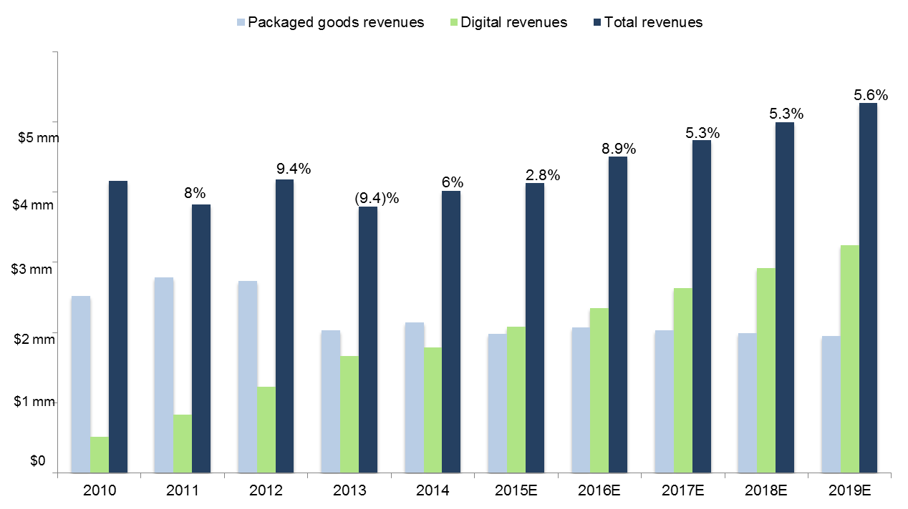
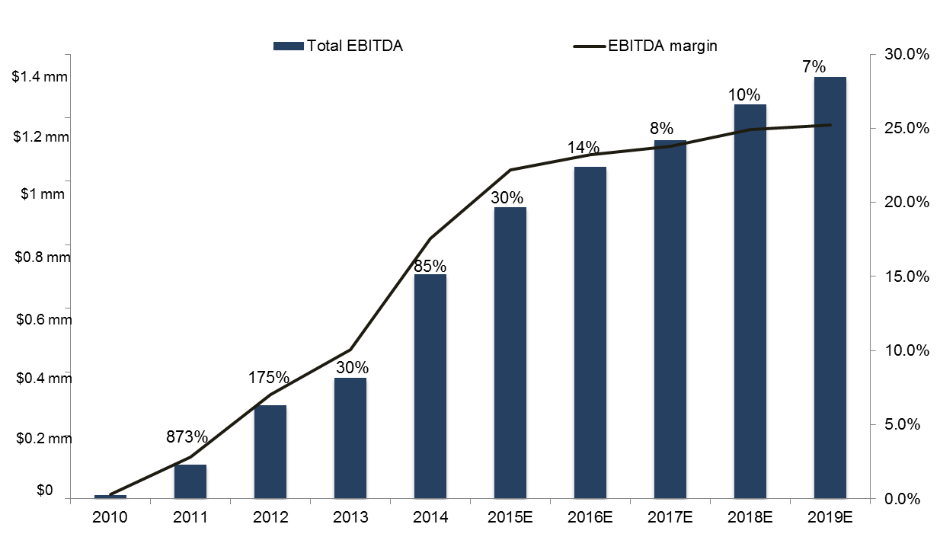
Company – Financial Forecast (Electronic Arts)
Total and Segmented Revenues
Trajectory
Significant growth in digital revenues while packaged goods are in decline Uplift in 2014 EBITDA due to significant margin expansion from higher digital mix
(In billions)
Positive Drivers
Management is focused on introducing cost cutting initiatives to improve margins, such as an increasingly focused marketing program Focus on producing less titles and directing a larger percentage of the budget to AAA releases Majority of growth in mobile / online gaming which accounts for less of EA’s core business Tighter integration of Gen 8 consoles with PlayStation Network and Xbox LIVE should support 2015 revenue growth in the digital segment FY 2015 revenue could see high growth due to 3rd year of console cycle historically being very profitable for game developers & publishers
Total Non-GAAP EBITDA and Margin
(In billions)
Negative Drivers
Growing competition and consolidation in the industry is putting pressure on margins and ability of companies to differentiate Dependency on AAA releases makes revenue and cash flow stream more volatile and difficult for management to forecast where to allocate budget Royalty expenses are expected to weigh on revenues for the next couple years Headwinds will surface for packaged goods revenue due to from transition to game development higher margin PC and mobile platforms

Slide 2

Company – Operating Cost (LGF)
Revenue Drivers
Breakdown of Growth in FY13 Film Revenues
  Film Segment: Intends to release 12-14 films/year from 20/year previously
  Success of the 3 remaining titles in Hunger Games franchise is highly probable and will support elevated level of film revenues
    Forecasted $2.7bn revenue from Hunger Games (85% to be realized in FY14-FY16)
  To reduce exposure, the company presells its film product to international markets
  TV Segment: Core competence is developing programming for cable networks
  TV revenues have grown at a 27% CAGR from FY07 to FY12
  For FY14, Lions Gate is expected to produce 60% more programming hours versus FY13
Revenue and EBITDA Forecast

Slide 3
Company – Capital Requirements (EA)
Capital requirements and development expenditures can comfortably be served from internal cashflows although EA retains significant cash on hand to opportunistically pursue acquisitions
  Capital Requirements
Massive, multi-player online games (MMOGs) require significant server capacity and need to be maintained frequently to create high quality experience
Deal flexibility is critical in industry with major players holding significant cash on hand to compete to acquire the best game developers
  Game development costs can be fairly intensive depending on type of game but are typically funded from internal cashflows
Upfront development costs comprise around 35% of sales and are typically incurred between 24 and 36 months
New open-word game "Destiny" developed by Activision-Blizzard is reported to cost $500m in development plus marketing costs
Debt Facility | Outs. ($m) | Avail. ($m) | Issued Maturity | Interest rate | Notes
Convertible Senior Unsecured Notes | $633 | $0 | 2011 / 2016 | 0.75% | $633mm outstanding; converts at $31.74/sh; used for acquisition of PopCap
Revolving Credit Facility | $0 | $500 | 2012 | adjusted LIBOR | $500m available; used for general corporate purposes

