Slide 1
Valuation – Trading Comparables (Wynn Resorts)
Company | Market | Enterprise | EV/Revenue ⁽³⁾ |  | EV/EBITDA ⁽³⁾ |  | P/E ⁽³⁾ |  | EBITDA CAGR (3yr) | EBITDA CAGR (2yr) | Total Debt /
Name | Cap. ⁽²⁾ | Value ⁽²⁾ | 2012E | 2013E | 2012E | 2013E | 2012E | 2013E | Historic | Forecast | Total Cap. ⁽⁴⁾
(all figures presented in USD millions, except per share figures or where noted)
International
Las Vegas Sands | 33,753 | 48,273 | 4.3x | 3.8x | 13.0x | 11.4x | 18.0x | 15.0x | 36.3% | 13.7% | 47.9%
MGM Resorts | 5,168 | 19,882 | 2.2x | 2.1x | 10.7x | 9.9x | N/A | N/A | (7.1%) | 9.6% | 58.7%
Average |  |  |  |  |  | 10.7x
Asia
MGM China | 6,559 | 6,437 | 2.3x | 2.1x | 9.5x | 8.8x | 11.8x | 11.0x | 78.4% | 10.4% | 51.1%
Sands China | 29,186 | 29,418 | 4.4x | 3.5x | 15.1x | 11.5x | 22.3x | 15.3x | 28.9% | 25.3% | 39.8%
SJM Holdings Limited | 12,135 | 9,985 | 1.0x | 0.9x | 10.2x | 9.1x | 14.6x | 12.8x | 19.5% | 12.4% | 21.5%
Melco Crown Entertainment | 7,489 | 8,666 | 2.2x | 2.1x | 10.0x | 9.7x | 20.2x | 18.6x | 83.9% | 9.1% | 40.7%
Galaxy Entertainment | 13,872 | 14,080 | 1.9x | 1.7x | 12.2x | 10.8x | 16.4x | 14.0x | 918.5% | 15.1% | 39.3%
Average |  |  |  |  |  | 10.0x
Las Vegas Stand Alone (Implied)
Caesars Entertainment | 781 | 20,169 | 2.3x | 2.2x | 10.0x | 9.3x | N/A | N/A | (4.7%) | 6.3% | 97.1%
Las Vegas Sands |  | 18,855 |  |  |  | 11.3x
MGM Resorts |  | 13,445 |  |  |  | 10.5x
Average |  |  |  |  |  | 10.3x
Small/Mid – Cap
Ameristar Casinos | 589.8 | 2,377.8 | 2.0x | 2.0x | 6.6x | 6.6x | 7.6x | 7.8x | 4.6% | 2.7% | 101.5%
Boyd Gaming Corp. | 592.3 | 4,163.5 | 1.7x | 1.7x | 8.6x | 8.5x | 100.9x | 89.1x | (3.7%) | 1.8% | 73.5%
Penn National Gaming | 3,289.0 | 5,193.9 | 1.8x | 1.6x | 6.8x | 5.9x | 12.5x | 10.9x | 2.8% | 10.2% | 49.7%
Pinnacle Entertainment | 760.7 | 1,984.9 | 1.6x | 1.5x | 6.8x | 6.3x | 13.2x | 14.2x | 7.3% | 5.2% | 72.9%
Average (unadjusted) |  |  |  |  |  | 6.8x
Average | 9,514.5 | 14,219.2 | 2.3x | 2.1x | 9.9x | 9.26x | 23.7x | 20.9x | 97.1% | 10.2% | 57.8%
Wynn Resorts | 11,547 | 18,661 | 3.6x | 3.4x | 12.6x | 11.9x | 20.5x | 18.3x | 40.3% | 8.0% | 90.2%
Wynn Macau | 13,752 | 13,274 | 3.4x | 3.1x | 12.9x | 11.7x | 16.0x | 14.2x | 31.6% | 11.0% | 29.5%
Wynn Las Vegas (Implied) |  | 5,387 |  |  |  | 12.5x
Sources: Bloomberg, Capital IQ
(1) Based on basic diluted shares outstanding
(2) Enterprise Value is defined as market capitalization, plus total debt and minority interests less cash and short-term investments; ignores equity investments
(3) Based on analyst consensus forecasts
(4) Total Capitalization defined as total debt plus book value of shareholders' equity and minority interests
(5) Calculated by adding market value of minority interest to EV of parent company, less EV of Asian property
(6) Calculated by subtracting EBITDA of Asian property from consolidated EBITDA

Slide 2
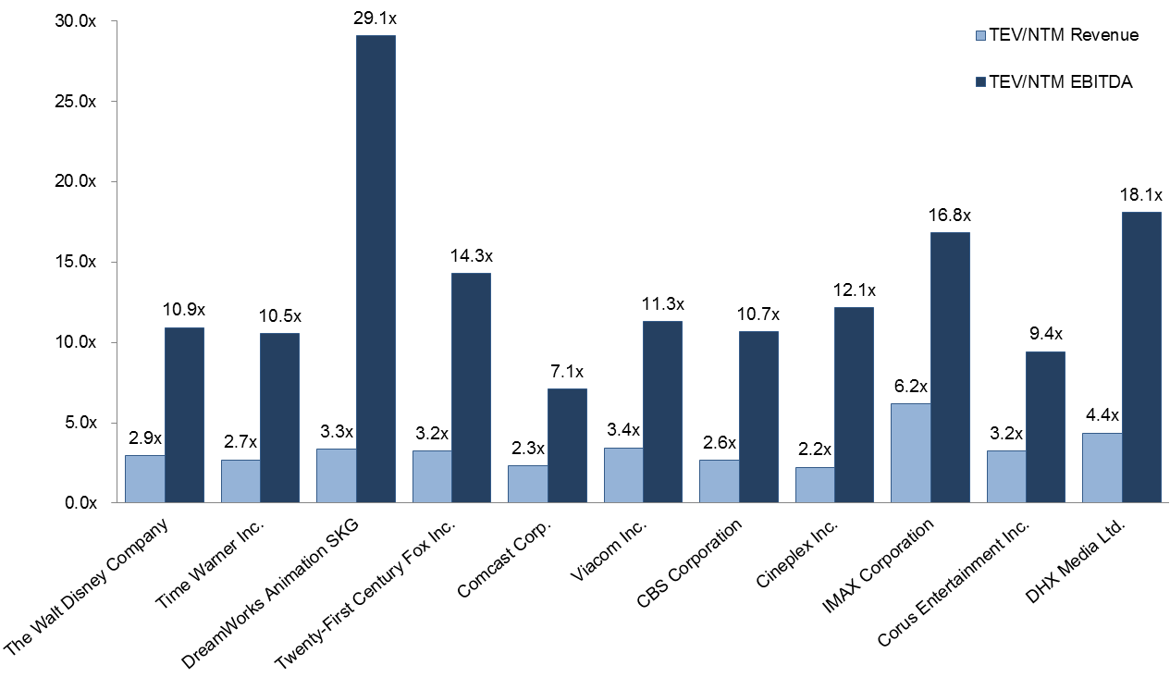
Valuation – Trading Comparables (LGF)
Trading Comparables Peer Group
VALUATION CONCLUSIONS
Media Conglomerates:
EV/EBITDA: 7.4x – 11.7x
EV/Revenue: 2.6x – 2.7x
P/E: 13.3x – 18.3x
Pure-Play Studios:
EV/EBITDA: 8.2x – 18.1x
EV/Revenue: 1.8x – 3.6x
P/E: 18.1x – 40.9x
Note: Higher multiples for studios versus conglomerates suggests premium on pure-play nature and/or high growth expectations for content
Multiples are NTM
LIONS GATE VALUATION
Current Market Valuation (based on FY14(e) and FY15(e) to reflect growth)
EV/EBITDA: 13.7x / 11.4x
EV/Revenue: 1.8x / 1.7x
P/E: 27.1x / 18.9x
Trading Comps Valuation (based on conglomerates and studios)
EV/EBITDA: $2.8bn – $6.8bn
EV/Revenue: $5.1bn – $10.2bn
P/E: $26.19 – $80.55 share price
Comparables Set: Includes both studios and media conglomerates due to scarcity of publicly traded pure-play studios Dreamworks: Dreamworks is closest publicly traded comparable to Lions Gate as film-focused pure-play studio with library value and similar size range (50% of Lions Gate) large discrepancy between EV/Revenue and EV/EBITDA multiple arises from very low EBITDA margin and negative Net Income DHX Media: DHX is also a pure-play studio but much smaller and operates in Canada

Slide 3
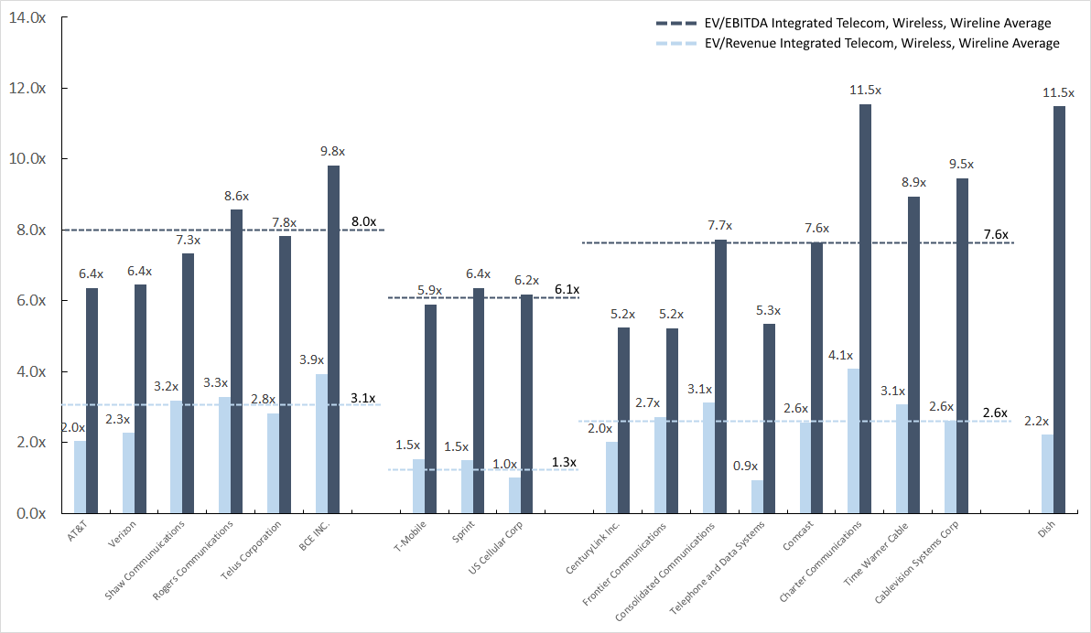
Valuation – Trading Comparables (AT&T)
AT&T trades at mid-to-upper end of wireless comps but discount to integrated telco’s and cable companies
AT&T Trading Comparables Dataset (NTM Forward Multiples)
MULTIPLES FOR VALUATION (NTM)
Integrated Telecom
EV/EBITDA: 6.4x – 9.8x (avg. 8.0x)
EV/Revenue: 2.3x – 3.9x (avg. 3.1x)
P/E: 11.7x – 22.4x (avg. 16.6x)
Wireless
EV/EBITDA: 5.9x – 6.4x (avg. 6.1x)
EV/Revenue: 1.0x – 1.5x (avg. 1.3x)
Wireline
EV/EBITDA: 5.2x – 11.5x (avg. 7.6x)
EV/Revenue: 0.9x – 4.1x (avg. 2.6x)
INTEGRATED
WIRELESS
CABLE
VALUATION OF AT&T
Current Market Valuation: $33.21
EV/EBITDA: 6.4x ($52.15bn EBITDA)
EV/Revenue: 2.0x ($163.18bn Revenue)
P/E: 11.9x ($16.12bn Earnings)
Trading Comparables Valuation (avg.)
EV/Revenue (Segmented): $35.48
EV/EBITDA (Segmented): $40.49
EV/Revenue (Combined): $57.05
EV/EBITDA (Combined): $50.08
Integrated Telecom: Established telecom providers operating in media, wireless and wireline are good direct comparisons to the combined operations of AT&T Wireless: Companies providing solely Wireless services in the US provide a good comparison to AT&T’s Wireless segment Wireline: Companies offering Wireline and Media services or pure Wireline services are a good comparison to both AT&T’s combined operations and its Wireline segment Satellite: Dish provides good valuation comparison to AT&T’s acquisition of DirecTV

Slide 4
Valuation – Trading Comparables (AT&T)
AT&T trades at mid-to-upper end of wireless comps but discount to integrated telco’s and cable companies
AT&T Trading Comparables Dataset (NTM Forward Multiples)
INTEGRATED
WIRELESS
CABLE

Slide 5
Valuation – Trading Comparables (AT&T)
AT&T trades at mid-to-upper end of wireless comps but discount to integrated telco’s and cable companies
Observations on AT&T Trading Comparables Universe
Integrated Telecom: Established telecom providers operating in media, wireless and wireline are good direct comparisons to the combined operations of AT&T Wireless: Companies providing solely Wireless services in the US provide a good comparison to AT&T’s Wireless segment Wireline: Companies offering Wireline and Media services or pure Wireline services are a good comparison to both AT&T’s combined operations and its Wireline segment Satellite: Dish provides good valuation comparison to AT&T’s acquisition of DirecTV
MULTIPLES FOR VALUATION (NTM)
Integrated Telecom
EV/EBITDA: 6.4x – 9.8x (avg. 8.0x)
EV/Revenue: 2.3x – 3.9x (avg. 3.1x)
P/E: 11.7x – 22.4x (avg. 16.6x)
Wireless
EV/EBITDA: 5.9x – 6.4x (avg. 6.1x)
EV/Revenue: 1.0x – 1.5x (avg. 1.3x)
Wireline
EV/EBITDA: 5.2x – 11.5x (avg. 7.6x)
EV/Revenue: 0.9x – 4.1x (avg. 2.6x)
VALUATION OF AT&T
Current Market Valuation: $33.21
EV/EBITDA: 6.4x ($52.15bn EBITDA)
EV/Revenue: 2.0x ($163.18bn Revenue)
P/E: 11.9x ($16.12bn Earnings)
Trading Comparables Valuation (avg.)
EV/Revenue (Segmented): $35.48
EV/EBITDA (Segmented): $40.49
EV/Revenue (Combined): $57.05
EV/EBITDA (Combined): $50.08

