Slide 1
Valuation – Analysis (Electronic Arts)
EA valuation is justifiable based on increase in digital in revenue mix, focus on providing additional content, and continued cost cutting although relies on achieving attractive forecast
Valuation Analysis
Key Valuation Statistics ($m)
Valuation: 9.7 for NTM EV/EBITDA is relatively strong but comes down to 9.1x for 2015E as EBITDA grows at CAGR of ~8.9%
Forecast: Seems achievable on back of strong FY 2014 EBITDA of $944m despite lower historical EBITDA of ~$500m in 2010-2013,
  Revenues are expected to increase by 2.8% in 2015E, 8.9% in 2016E and 5.3% thereon due to growing digital market as well as mature stage of console cycle (2016)
  EBITDA margin is forecasted to improve from 25.1% in 2015E to 27.7% in 2019, due to games being delivered online, fewer titles and cost saving initiatives
WACC: Relatively low at 10.4% with moderate beta of 1.15 given uncorrelated hit-driven business but dependency on disposable income
Business: Stable as 3rd largest games publisher (10.7% of global market) and long-standing franchises (FIFA Soccer, Battlefield, Sims)
EV* | $9,511 | Revenue | $4,021
Market Cap* | $11,241 | EBITDA | $944
P/E* | 19.6x | EBITDA Margin | 23.5%
EV/EBITDA* | 9.7x | Net Debt / EV | (10.8%)
Cash | $2,316 | Total Debt | $580
*As of September 26^{h}, 2014
**All other figures as of FY14 (year end March 31st, 2014)
Positive Valuation Drivers
Larger revenue mix attributable to digital goods and delivery should contribute to higher margins
High industry growth in mobile, social and casual gaming
Continued cost cutting initiatives should boost free cash flows
Year | EV / EBITDA* | EBITDA* ($m) | %∆ | Revenues * ($m) | %∆
2011 | 9.3x | 493 | 27.1% | 3,828 | 8.0%
2012 | 7.2x | 613 | 24.3% | 4,184 | 9.4%
2013 | 7.0x | 631 | 2.9% | 3,793 | (9.4)%
2014 | 10.0x | 944 | 49.6% | 4,021 | 6.0%
2015E | 9.2x | 1,037 | 9.9% | 4,132 | 2.8%
2016E | 8.2x | 1,156 | 11.5% | 4,501 | 8.9%
Valuation Concerns
Focus on more AAA but fewer titles overall increases revenue volatility (Star Wars franchise was very expensive but not successful)
Increased competitive threat from successful franchises of merged Activision-Blizzard
Higher growth in mobile, social and casual gaming segment versus console were EA has market leadership
Customers unsatisfied about rushed development and customer service
*Based on Non-GAAP
2011-2013 multiples based on historic figures
2014-2016 multiples based on current EV

Slide 2
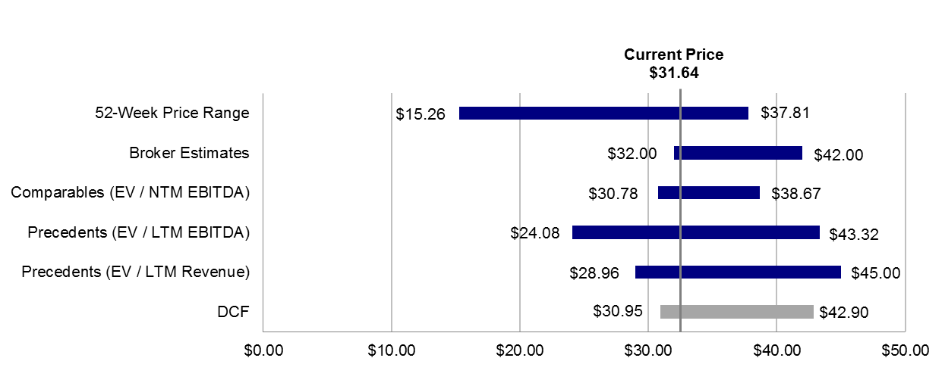
Valuation – Summary (LGF)
Stock Price Performance
Valuation Football Field
Stock has outperformed based on strong cashflows from Twilight and Hunger Games in 2012
Current multiples are high but compress in FY14 / FY15 as growth is realized
Industry multiples support share price but only if Hunger Games meets its forecast
Further upside could be possible if another hit is produced but downside risk is more significant
Lions Gate produced limited or no free cashflows in 2007-2011 despite big successes like Saw
Current: $31.64 | High: $15.26 / | Low: $37.81
Valuation Metrics | Lions Gate | Trading | Precedents | Warner**
EV/EBITDA* | 13.7x / 11.4x | 7.4x – 18.1x | 8.3x – 27.6x | 10.1x
EV/Sales* | 1.8x / 1.7x | 1.8x – 3.6x | 1.2x – 5.3x | 2.7x
P/E* | 27.1x / 18.9x | 13.3x – 40.9x | 21.2x | 17.1x
EBITDA Margin | 9.5% | 23% – 30% | 3% – 55% | 23.2%
Net Income Margin | 8.5% | 8% – 15% | 26% | 12.7%
*P/E and EV/EBITDA are based on FY14 and FY15 to reflect imminent growth; **based on FY14
Broker Estimates (M/D/Y) | Results |  | Period | Revenues ($mm) | EBITDA($mm) | EBITDA Margin (%) | EV/EBITDA | P/E
RBC (11/18/2013) | Target Price | $38.00 | 2014E | 2,791 | 359 | 12.9% | NA | NA
 | EV ($mm) | NA | 2015E | 2,887 | 407 | 14.1% | NA | 26.1x
J.P. Morgan (05/31/2013) | Target Price | $32.00 | 2014E | 2,651 | 345 | 13.0% | 13.9x | 24.7x
 | EV ($mm) | $4,795 | 2015E | 2,851 | 408 | 14.3% | 11.8x | 18.2x
Evercore (11/10/2013) | Target Price | $42.00 | 2014E | 2,877 | 375 | 13.0% | 13.2x | 30.7x
 | EV ($mm) | $4,945 | 2015E | 3,049 | 471 | 15.4% | 10.5x | 20.2x

Slide 3
Valuation – Summary (GUY)
Factors Affecting GUY Stock Price | GUY Valuation
GUY appears to be valued fairly relative to peer group but peer group valuation has come down recently Current Price low relative to Two-Year Trading Range due to recent drop in sector and overall market index One-year Analyst forecasts are optimistic due to: Expected de-risking of asset priced into target Expected resource update (Q1 2012) There may be benefit to further de-risking as current valuation may not be optimal time to sell
Broker | Target Price on NAVPS |  | L-t Gold Price | Current | Target | Recovered Resources | Avg. Yearly Production | Avg. Yearly Cash Costs¹ | Estimated Mine Life | Initial CapEx
 |  |  | ($/oz) | P/NAV | P/NAV | (mm oz Au) | (000 oz Au) | (US$/oz) | (years) | ($ mm)
Brokerage 1 | Target Price | $14.14 | $1,500 | 0.57x | 1.14x | 5.90 | 280 | $524 | 21 | $400
 | Current NAVPS | $12.40
Brokerage 2 | Target Price | $11.88 | $1,425 | 0.65x | 0.91x | 5.60 | 311 | $527 | 18 | $400
 | Current NAVPS | $13.05
Brokerage 3 | Target Price | $10.00 | $1,500 | 0.78x | 0.92x | 4.70 | 261 | $588 | 19 | $400
 | Current NAVPS | $10.89
Average | Target Price | $12.60 | 1,475 | 0.60x | 1.00x | 5.40 | 284 | $546 | 19 | $400
 | NAVPS | $12.70
Management | NAVPS | $11.49 | $1,375 | 0.74x |  | 4.80 | 282 | $500 | 17 | $400
Source: analyst reports; LOM quantities; cash costs include royalties; NAV only includes Aurora project; NAV results reflect differences not shown in this table

