Slide 1
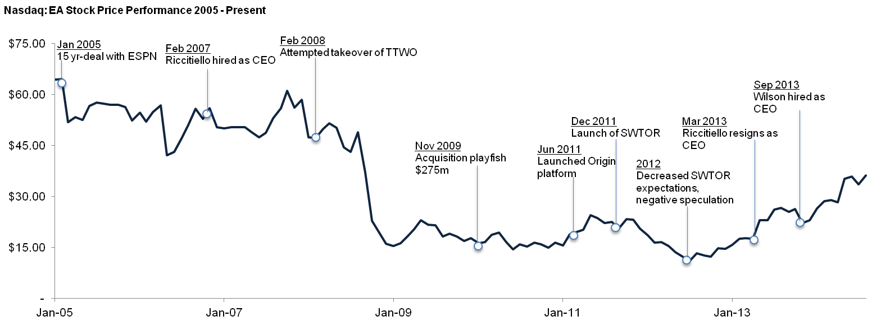
Valuation – Share Price (Electronic Arts)
Key Events & Share Price Drivers
Jan 2005 – EA signed a 15-year licensing deal with ESPN, which provided EA with exclusive access to its programming and personalities
Feb 2008 – EA made an all-cash bid of $26/share, approximately $2bn, for Take-Two Interactive, representing a 64% premium over closing price of $15.83 on Feb 15th. Take-Two refused and the offer expired in Sep 2008
Dec 2011 – With estimated costs totaling $200m, Star Wars: The Old Republic ranked as one of most expensive games ever developed. As revenue from subscription decreased in 2012, EA dropped the subscription fee for a free-to-play model
Mar 2013 – Riccitiello steps down as EA’s CEO over the company’s poor financial performance in the quarter. He was credited for diversifying EA’s business model, but was unable to boost earnings and stock price in response to trends in the industry
Apr 2013 – EA voted as the second worst company by consumers for rushing through game development, poor game releases and forcing players to purchase extra content through microtransactions despite the already expensive flat price
Sep 2013 – Andrew Wilson appointed new CEO with a focus on continued transition into a more digital future and instilling a culture of operational excellence / execution and overall cost efficiency

