Slide 1
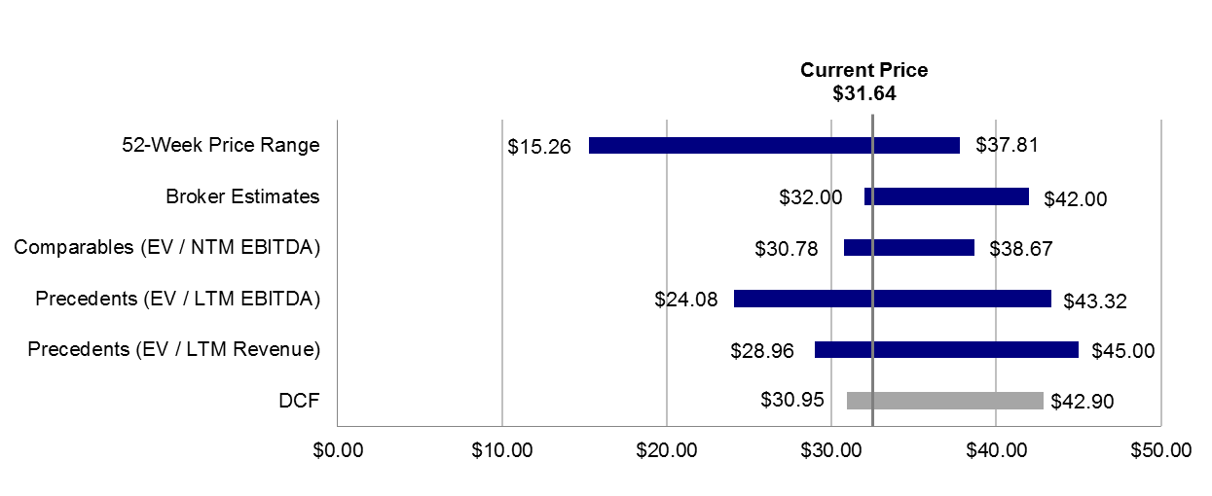
Valuation Summary (LGF)
Stock Price Performance
Valuation Football Field
Stock has outperformed based on strong cashflows from Twilight and Hunger Games in 2012
Current multiples are high but compress in FY14 / FY15 as growth is realized
Industry multiples support share price but only if Hunger Games meets its forecast
Further upside could be possible if another hit is produced but downside risk is more significant
Lions Gate produced limited or no free cashflows in 2007-2011 despite big successes like Saw
Current: $31.64 | High: $15.26 / | Low: $37.81
Valuation Metrics | Lions Gate | Trading | Precedents | Warner**
EV/EBITDA* | 13.7x / 11.4x | 7.4x – 18.1x | 8.3x – 27.6x | 10.1x
EV/Sales* | 1.8x / 1.7x | 1.8x – 3.6x | 1.2x – 5.3x | 2.7x
P/E* | 27.1x / 18.9x | 13.3x – 40.9x | 21.2x | 17.1x
EBITDA Margin | 9.5% | 23% – 30% | 3% – 55% | 23.2%
Net Income Margin | 8.5% | 8% – 15% | 26% | 12.7%
*P/E and EV/EBITDA are based on FY14 and FY15 to reflect imminent growth; **based on FY14
Broker Estimates (M/D/Y) | Results |  | Period | Revenues ($mm) | EBITDA($mm) | EBITDA Margin (%) | EV/EBITDA | P/E
RBC (11/18/2013) | Target Price | $38.00 | 2014E | 2,791 | 359 | 12.9% | NA | NA
 | EV ($mm) | NA | 2015E | 2,887 | 407 | 14.1% | NA | 26.1x
J.P. Morgan (05/31/2013) | Target Price | $32.00 | 2014E | 2,651 | 345 | 13.0% | 13.9x | 24.7x
 | EV ($mm) | $4,795 | 2015E | 2,851 | 408 | 14.3% | 11.8x | 18.2x
Evercore (11/10/2013) | Target Price | $42.00 | 2014E | 2,877 | 375 | 13.0% | 13.2x | 30.7x
 | EV ($mm) | $4,945 | 2015E | 3,049 | 471 | 15.4% | 10.5x | 20.2x

