Slide 1
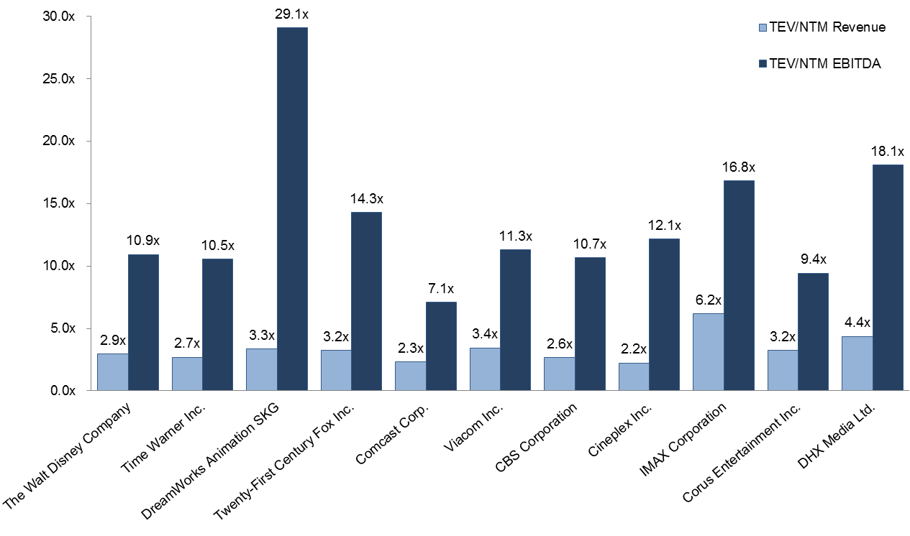
Trading Comparables (LGF)
Trading Comparables Peer Group
VALUATION CONCLUSIONS
Media Conglomerates:
EV/EBITDA: 7.4x – 11.7x
EV/Revenue: 2.6x – 2.7x
P/E: 13.3x – 18.3x
Pure-Play Studios:
EV/EBITDA: 8.2x – 18.1x
EV/Revenue: 1.8x – 3.6x
P/E: 18.1x – 40.9x
Note: Higher multiples for studios versus conglomerates suggests premium on pure-play nature and/or high growth expectations for content
Multiples are NTM
LIONS GATE VALUATION
Current Market Valuation (based on FY14(e) and FY15(e) to reflect growth)
EV/EBITDA: 13.7x / 11.4x
EV/Revenue: 1.8x / 1.7x
P/E: 27.1x / 18.9x
Trading Comps Valuation (based on conglomerates and studios)
EV/EBITDA: $2.8bn – $6.8bn
EV/Revenue: $5.1bn – $10.2bn
P/E: $26.19 – $80.55 share price
Comparables Set: Includes both studios and media conglomerates due to scarcity of publicly traded pure-play studios Dreamworks: Dreamworks is closest publicly traded comparable to Lions Gate as film-focused pure-play studio with library value and similar size range (50% of Lions Gate) large discrepancy between EV/Revenue and EV/EBITDA multiple arises from very low EBITDA margin and negative Net Income DHX Media: DHX is also a pure-play studio but much smaller and operates in Canada

