Slide 1
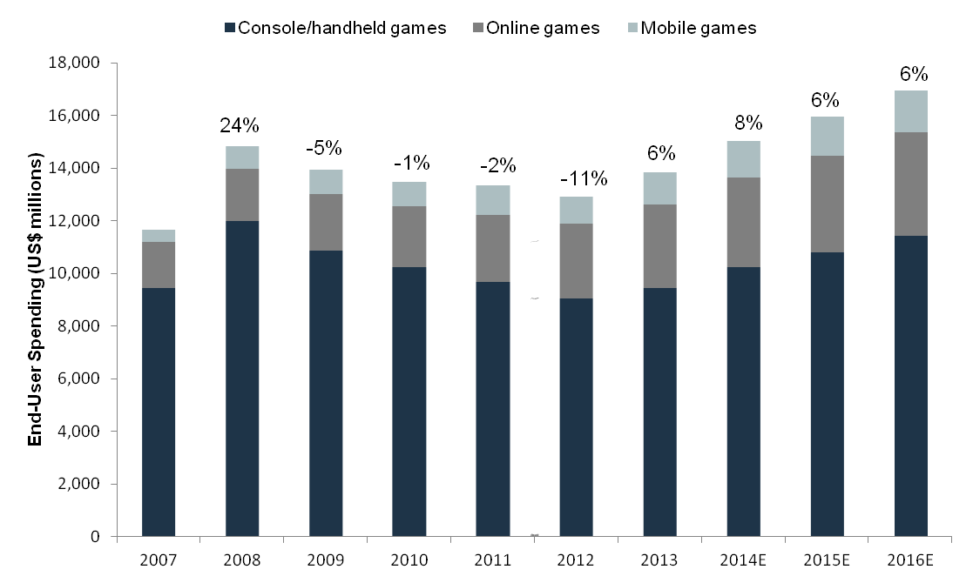
Industry Summary (Video Games)
Key trends, statistics and components of the video gaming industry.
Industry Overview
North America Revenue by Major Segment (2014)
Physical games and software | $16.9bn
Consoles | $13.3bn
Online games and software | $7.0bn
Total revenue | $40.9bn
Forecasted 5-year revenue growth | 6.1%
EBITDA margins | 19.7% - 36.8%
North America Industry Characteristics
Total Debt/EBITDA | 3.5x
Total Debt/EV | 10%
EBITDA margin | 16.3%
EV/EBITDA | 8.0 – 10.4x
Cash Ratio | 1.1x
Market share held by 5 majors | 40.7%
Global Industry
Total revenues | $68bn
Forecasted 5-year revenue growth | 6.7%
Revenue Profile
Market declined in 2008 onwards due to dependency on discretionary spending but has been relatively resilient
Market has picked up in since 2012 due to improved confidence and growth in mobile/online segment
North America Video Game Industry by Segment ($bn)
Global industry sales by region (2012)
Average distribution of sales for video game publishers in 2014 (EA, ATVI, TTWO, UBI)
GTA by Take Two. Sales of GTA V ~$2bn. Sales in the first three days $1bn.

